Slide 1

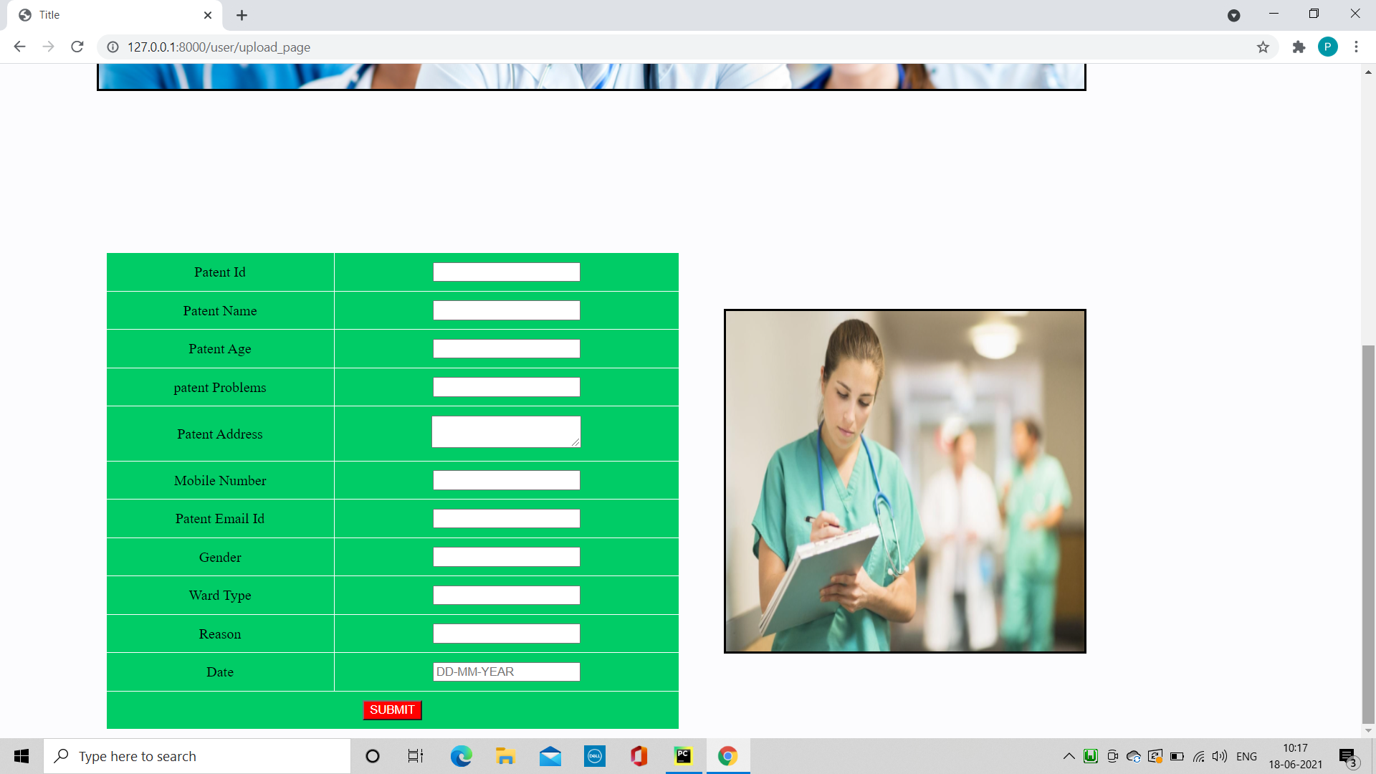
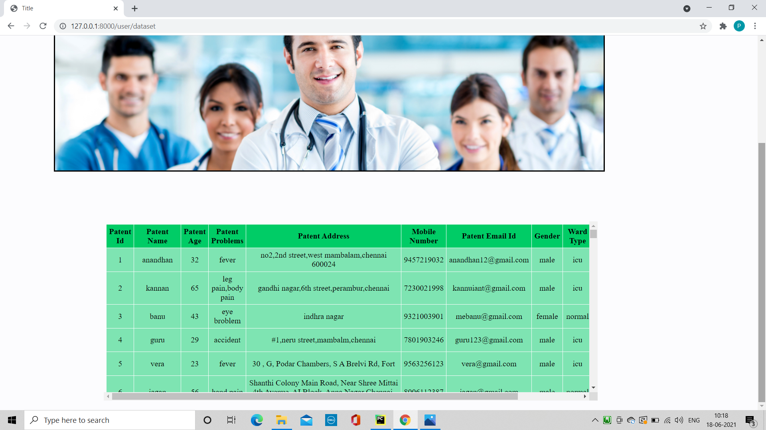
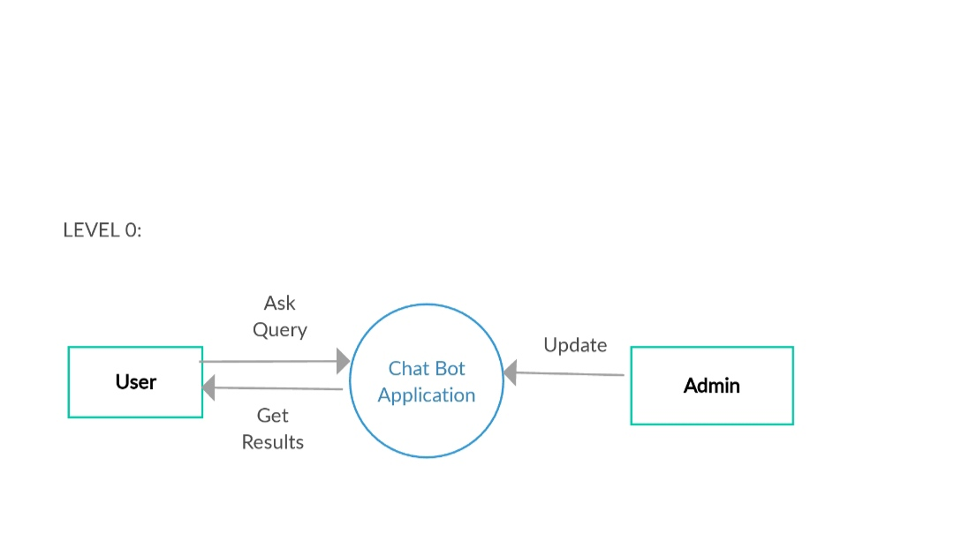
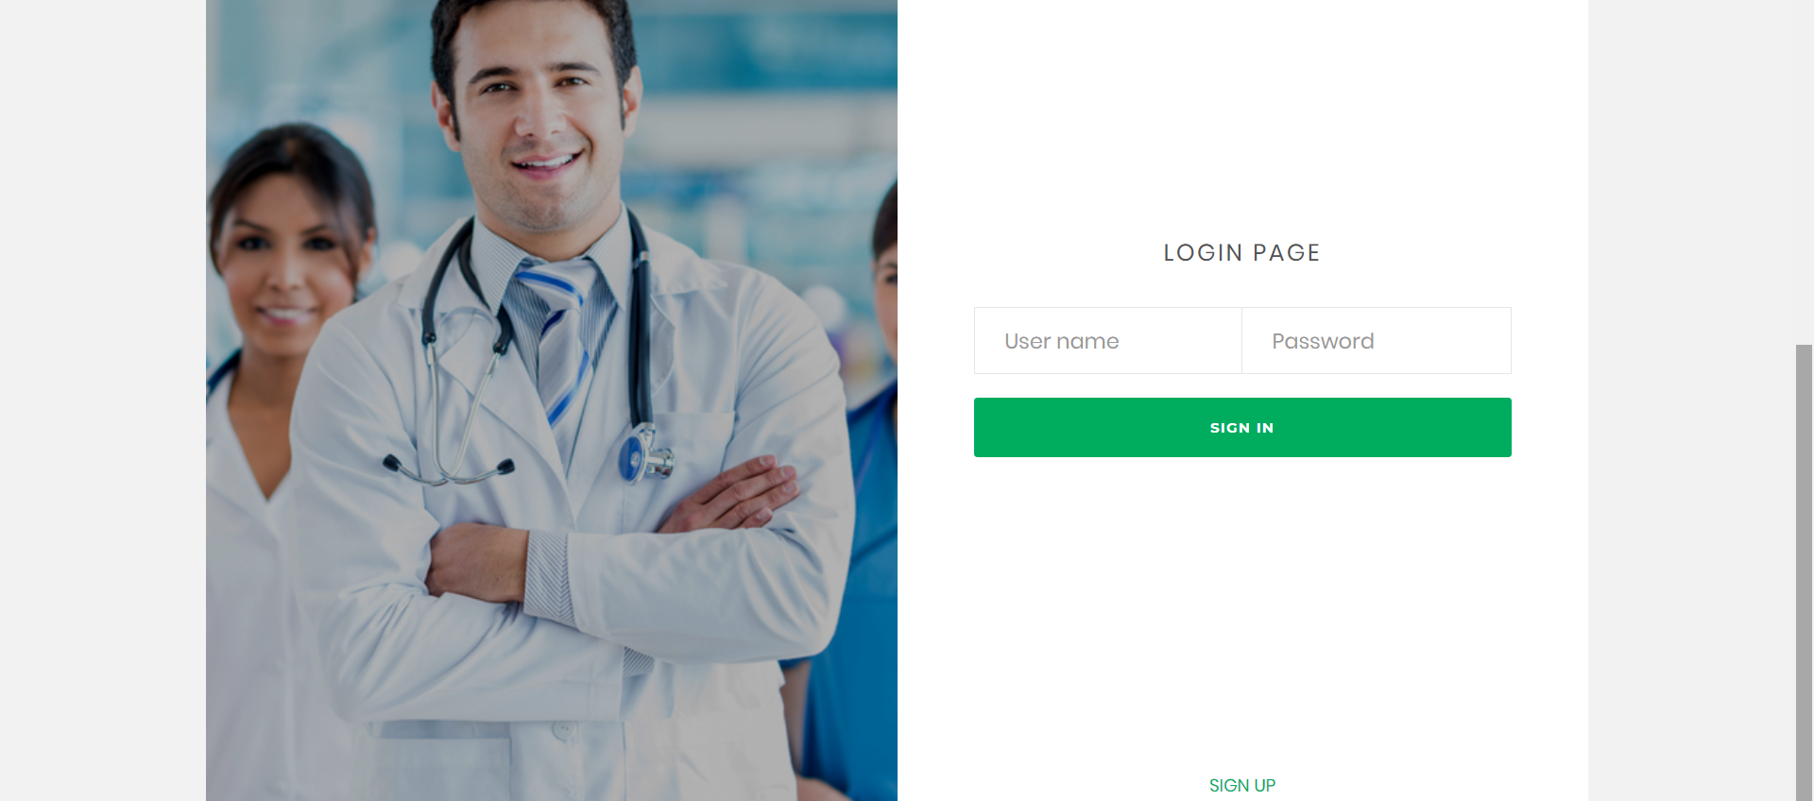
SHRI RAMSWAROOP MEMORIAL GROUP OF PROFESSIONAL COLLEGES
DEPARTMENT OF INFORMATION TECHNOLOGY
CHATBOT SOFTWARE DEVELOPMENT
PROJECT MEMBERS:
SHIVAM PANDEY (1712213069)
PRASHANT UPADHYAY(1812213801)
UNDER THE GUIDANCE OF:
Mrs. SHILPI KHANNA
INTRODUCTION
A chatbot is an intelligent piece of software that is capable of communicating and performing actions similar to a human. Chatbots are used a lot in customer interaction, marketing on social network sites and instantly messaging the client.
A chatbot is a software application used to conduct an on-line chat conversation via text of providing direct contact with a live human agent
OBJECTIVES
A chatbot is a software application used to conduct an on-line chat conversation via text or text-to-speech, in lieu of providing direct contact with a live human agent.
Increase operational efficiency.
Automatic customer request fulfillment.
Handling basic queries, which is turn free employees to work for complex and higher value enquiries.
Improve the response rate as well as customer engagement.
ADVANTAGES
Increase Customer Intraction.
Available 24/7.
Save Money.
Improve Customer Satisfactions.
Gaining a deeper understanding of customers
PROPOSED METHODOLOGY
LIMITATIONS
We propose iterative waterfall model. In this classical model used in system development life cycle to create a system with a linear and sequential approach. It is termed as waterfall because the model develops systematically from one phase to another in a downward fashion.
These chatbots are programmed in a way that they only know what they are taught. They cannot understand humans’ context.
Another limitation of chatbots is that they lack decision-making. They don’t have the right know-how to differentiate between the good and the bad.
chatbots have no emotions, and they cannot relate to any low situation.
MODULE DESCRIPTION
CONCLUSIONS
LOGIN
UPLOAD PATENT DETAIL
CLASSIFICATION ADMISSIONS DETAILS
PREDICT HOSPITAL ADMISSIONS
ANALYSIS
CHATBOT
From my perspective, chatbots or smart assistants with artificial intelligence are dramatically changing businesses.
Chatbots can reach out to a large audience on messaging apps and be more effective than humans. They may develope into a capable information-gathering tool in the near future.
0 LEVEL DFD
FUTURE SCOPE
The future of chatbots is that businesses will automate simple payments and allow users to pay directly over live chat or Facebook Messenger apps.
The instant process makes the customer happy and improves customer satisfaction. MasterCard has also launched a chatbot, especially for customer payments.
SCREENSHOTS
REFERENCES
B. A. Shawar and E. Atwell, “Chatbots: are they really useful?”, LDV Forum, vol. 22, no. 1, (2007).
“Pandorabots Chatbot Hosting Platform. SARANG Bot”, (2015) April 19, Internet: http:// pandorabots.com/pandora/talk?botid=9f0f09a71e34dcf8
A. M. Turing, “Computing Machinery and Intelligence”, Mind, (1950), pp. 433-460

